Slide 1
Project II Content-Centric Networking construction
TA: Jun-Bin Zhang, Sheng-Hui Peng, An-Fong Li
Office Hour: 15:00 - 18:00 Monday
13:00 - 18:00 Wednesday
At 95521 CPS Lab or LINE or Email
p78083025@ncku.edu.tw
2021.05.05

Slide 2
Outline
Introduction
Project 2
Network topology
CCN construction
Format
Test data
Output_interest and Output_data
Process Flow
Coding

Slide 3
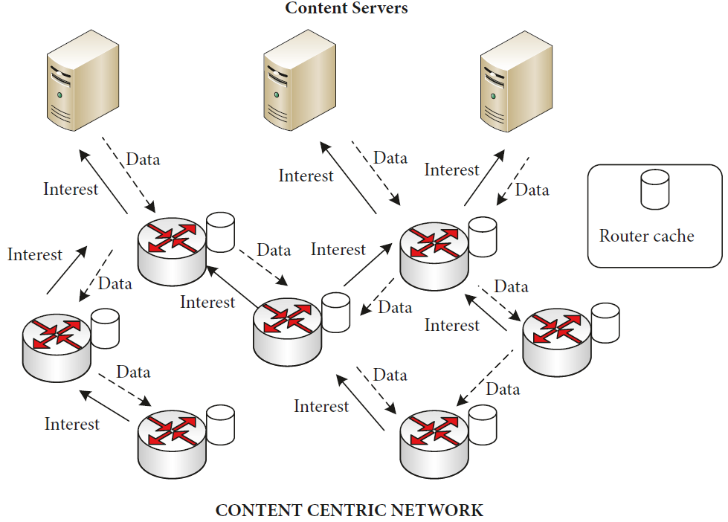
1. Introduction
Content-Centric Networking (CCN)
Use content name to replace IP addresses.
Focus on what users want.
Cache content on the router.
Get content responses from nearby routers without routing to servers or producers.

Slide 4
1. Introduction
Interest Packet and Data Packet
Content Store (CS), Pending Interest Table (PIT), Forwarding Information Base (FIB).
Producer Store (PS)
CCN packet format.
Content-Centric Network architecture diagram.

Slide 5
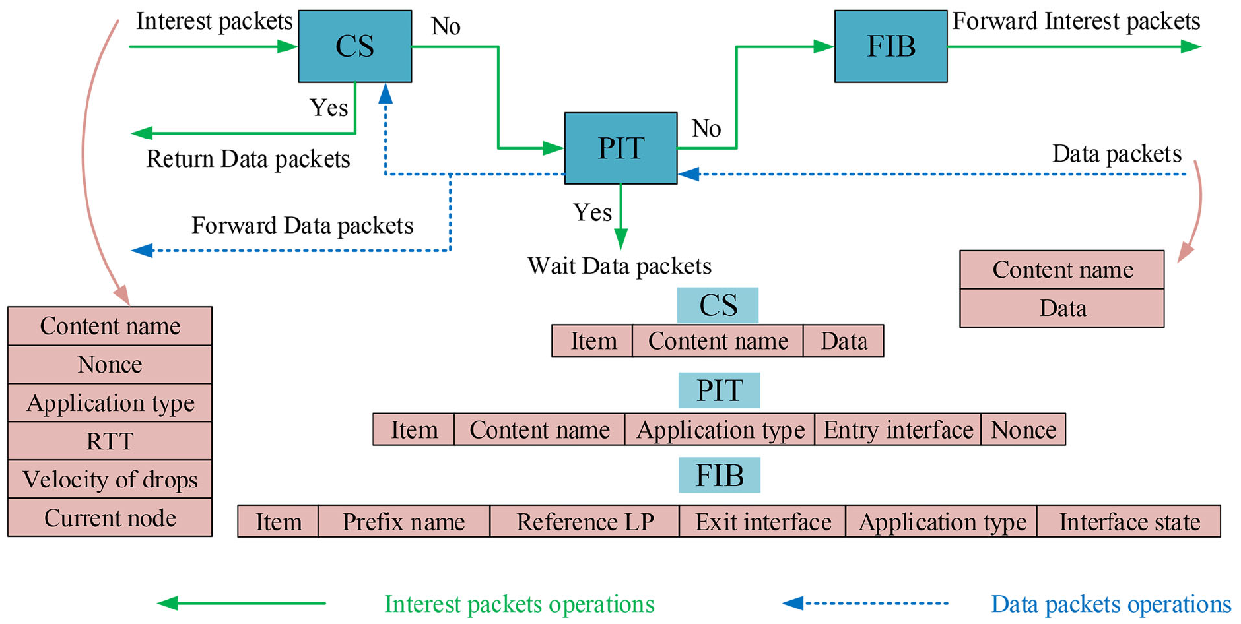

1. Introduction
2019 Intelligent Information-Centric Networking routing scheme under imprecise information.pdf
Notes:
如果感興趣的内容名稱在當前節點的CS中找到匹配項，則將相應的内容數據攜帶到請求節點； 否則，興趣封包將搜索該節點的PIT。 如果興趣封包可以在PIT中找到匹配項，則興趣封包只需要等待數據封包回傳即可。 否則，興趣封包搜索該節點的FIB，然後根據出口接口將興趣封包轉發到下一個節點。
數據封包在當前節點的PIT中找到匹配項，然後將其轉發到除其前節點之外的所有鄰居節點。 然後，數據封包搜索節點的CS。 如果CS不滿，則將內容緩存到CS。 否則，執行替換策略。

Slide 6
2. Project 2
You should create this CCN network based on project 1.
1. Construct a CCN simulator
interest.py、data.py、forward.py、ps.py、pit.py、cs.py、fib.py ......
2. Creat tables
Queue、PS、PIT、CS、FIB
Tip:
In Project 2, CS and FIB are not used, but in Project 3 they are optimized objects. That is to say, the interest packet only goes to the PS to find whether there is matching content data, not to the CS. CS also does not cache the content data in the data packet. Interest packets can only get content from the producer.
FIB is also empty and does not record routing information of data packets.
When the interest packet needs to be forwarded, it is sent to all its neighbors by broadcasting, and you can read the network to obtain neighbor connection information.

Slide 7
2. Project 2
3. Test CCN simulator
Input
read 'peremiters、networks、interests、contents of producer' json files.
run your CCN simulator.
Output
real-time output packets information to save in csv files (interest.csv and data.csv).
Interest Output.CSV format
= ["Time"=str(int(time.time()-interest['run_start_time']), "Type"=interest['type'], "Interest_ID"='I'+str(interest['interest_ID']), "Consumer_ID"='C'+str(interest['consumer_ID']), "Route_ID"='R'+str(interest['route_ID']), "Content_name"=interest['content_name'], "Interest_hop"=interest['interest_hop'], "Path"=interest['path'], "Result"='Interest hit in PS', "Hit"=1, "Miss"=0]

Slide 8
2. Project 2
3. Test CCN simulator
Input
read 'peremiters、networks、interests、contents of producer' json files.
run your CCN simulator.
Output
real-time output packets information to save in csv files (interest.csv and data.csv).
Data Output.CSV format
=["Time"=str(times-data['run_start_time']), "Type"=data['type'], "Consumer_ID"='C'+str(data['consumer_ID']), "Route_ID"='R'+str(data['route_ID']), "Content_name"=data['content_name'], "Data_hop"=data['data_hop'], "Path"=data['path'], "Result"='Data miss in PIT', "Hit_consumer"=0, "Hit_PIT"=0, "Hit_Miss"=1]

Slide 9
2. Project 2
Code
python
Upload
2021.06.02 10:00 am upload to moodle
Filename
project2_group1_V1.rar

Slide 10
2. Project 2
DEMO
Time: 2021.06.02
Location: 95519 room
If you successfully establish CCN.
Explain the idea of establishing a CCN simulator. Run the CCN simulator to
output the interest packet and data packet information respectively.
If you try to establish a CCN, but it is not work.
Explain your work and answer some of our questions about the PPT of Project 2.
If you haven't tried to establish CCN.
Answer some of our questions about the PPT of Project 2.

Slide 11
3. Network topology
Each node is both a producer and a consumer.
Numbers represent router ID and consumer ID
As a producer, router0 will publish the content name with its own router name prefix, for example 'r0/'. Each producer publishes 100 pieces of content, such as 'r0/00-99'.
As a consumer, router6 can send out an interest packet to request any content name with a router name prefix, such as 'r6/88'.

Slide 12
4. Process Flow
return data
output hit
YES
interest
name
hit ?
Router
process interest
Sever
> queue_size
drop interest
interest queue
PS
NO
output miss
NO
life_hop>5 ?
YES
router0, ..., router11
drop interest
PIT
drop interest
N interests / s
interest
name
packet
type ?
hit ?
YES
mage inface to PIT entry
network
accept
output hit
data
NO
name
data
> queue_size
drop data
PIT
data queue
create a PIT entry
hit ?
YES
get infaces in PIT entry
brocast all neighbors
NO
output miss
Yes consumer
drop data
router ID
==
consumerID ?
output hit
YES
get outfaces in network
NO
Router
process data
add outfaces to PIT entry
forward datas
sever
remove PIT entry
forward interests
sever

Slide 13
5. CCN construction
main.py
sever.py
network.py
ps.py
pit.py
cs.py
fib.py
interest.py
data.py
forward.py

Slide 14
6. Format
Route_ID = 0 1 ... 11
Consumer_ID = 0 1 ... 11
Interest_ID = routerID + 0-99 ex. 0000, 0001, 1000... 1100
Content_name = 'route_ID/0-99' ex. 'r0/00'
Tip:
When output packet informaton to CVS, please convert router ID, consumer ID, interest ID into string type, and add ‘R’, ‘C’,’I’ in front.
ex. ‘R1’, ‘C10’, ’I1003’

Slide 15
6. Format
network = {'r'+'route_ID': [route_ID, ...], ... }
ex. network = {'r1': [0, 2], 'r2': [1, 3, 4], ... }
producer_contents = {'r'+'route_ID': [content_name, ...], ... }
ex. producer_contents = {'r0': ['r0/00', 'r0/01', ..., 'r0/99'], 'r1': ['r1/00', 'r1/01', ..., 'r1/99'], ... }
Tip:
You can read directly from the json file we provide. Then read each router's own part according to the router ID.

Slide 16
6. Format
Interest packets sent by consumer
start_packets = [{'type': 'interest', 'interest_ID': '0000', 'consumer_ID': 0, 'route_ID': 0, 'content_name': 'r4/01', 'interest_hop': 0, 'life_hop': 5, 'run_start_time': 1615357629, 'path': '0'}, .....
{'type': 'interest', 'interest_ID': '0004', 'consumer_ID': 0, 'route_ID': 0, 'content_name': 'r7/08', 'interest_hop': 0, 'life_hop': 5, 'run_start_time': 1615357629, 'path': '0'}]
Tip:
Consumers send new interests to the network at a certain frequency. You can read by router ID and order from the interest json file.
Then, the interests you read from the json file only contains the interest ID and content name, so you need to add other information about the interest in the above format.
run_start_time is the time when the simulator starts to run. It is used to calculate how many seconds the current simulator has executed.

Slide 17
6. Format
Interest packets received by router
interest = {'type': 'interest', 'interest_ID': 0000, 'consumer_ID': 0, 'route_ID': 0, 'content_name': 'r0/00', 'interest_hop': 0, 'life_hop': 5, 'run_start_time': 0, 'path': 'p0/'}
'route_ID': The router ID of the previous router that forwarded the interest, not the current router_ID.
'interest_hop' : Add 1 every time interest are forwarded
'life_hop': The maximum number of times an interest is forwarded
'run_start_time': The time when the simulator started running
'path': The current router_ID is added every time the interest is forwarded, and "/" is added.
Tip:
The router forwards an interest once, and the number of interest_hop + 1. The same is true for the number of data_hop in the data packet.
When the router receives an interest, it will read life_hop and determine whether it is > 5. If yes, the interest droped and not be stored in the queue.

Slide 18
6. Format
Data packets received by router
data = {'type': 'data', 'consumer_ID': 0000, 'route_ID': 0, 'content_name': 'r0/00', 'content_data': 'r0/000', 'data_hop': 0, 'run_start_time': 0, 'path': 'p0/'}
'route_ID': The router ID of the previous router that forwarded the data packet, not the current router_ID.
'content_data': = 'content_name' + str(current time)
'data_hop' : Add 1 every time data packet is forwarded
'run_start_time': The time when the simulator started running
'path': The current router_ID is added every time the data packet is forwarded, and "/" is added.
Tip:
The router forwards an data packet once, and the number of data_hop + 1.

Slide 19
6. Format
ps = [content_name, ...]
pit = {'content_name': [[inface, ...], [outface, ...]], ... }
pit_entry = [[inface, ...], [outface, ...]]
cs = [[content_name, data, time, cost], ... ]
cs_entry = [content_name, data, time, cost]
fib = {'content_name': [[outface, cost, time], ...], ... }
fib_entry = [[outface, cost, time], ...]
Tip:
CS and FIB will not be used in project 2, but you can write the program first. Each router has these tables independently.

Slide 20
6. Format
interest hit in PS
Create a data packet, the format is as follows
data packet =
[[5, {'type': 'data', 'consumer_ID': 0, 'route_ID': 4, 'content_name': 'r4/01', 'content_data': 'r4/011615357625', 'data_hop': 1, 'run_start_time': 1615357618, 'path': 'p4/'}]]
'content_data': = 'content_name' + str(current time)

Slide 21
6. Format
interest miss in PS
Create forwarding interest packets, which may need to be forwarded to multiple outgoing interfaces. The first number of each list is the outgoing interface (router ID). The format is as follows
interest packets =
[[3, {'type': 'interest', 'interest_ID': '0001', 'consumer_ID': 0, 'route_ID': 5, 'content_name': 'r7/07', 'interest_hop': 3, 'life_hop': 5, 'run_start_time': 1615357599, 'path': 'p0/3/5'}],
[4, {'type': 'interest', 'interest_ID': '0001', 'consumer_ID': 0, 'route_ID': 5, 'content_name': 'r7/07', 'interest_hop': 3, 'life_hop': 5, 'run_start_time': 1615357599, 'path': 'p0/3/5'}],
[5, {'type': 'interest', 'interest_ID': '0001', 'consumer_ID': 0, 'route_ID': 5, 'content_name': 'r7/07', 'interest_hop': 3, 'life_hop': 5, 'run_start_time': 1615357599, 'path': 'p0/3/5'}]]

Slide 22
6. Format
data hit in PIT
Create forwarding data packets, which may need to be forwarded to multiple incoming interfaces. The first number of each list is the incoming interface (router ID). The format is as follows
data packets =
[[2, {'type': 'data', 'consumer_ID': 0, 'route_ID': 4, 'content_name': 'r5/09', 'content_data': 'r5/091615357621', 'data_hop': 2, 'start_time': 1615357615, 'path': 'p5/4/'}],
[6, {'type': 'data', 'consumer_ID': 0, 'route_ID': 4, 'content_name': 'r5/09', 'content_data': 'r5/091615357621', 'data_hop': 2, 'start_time': 1615357615, 'path': 'p5/4/'}]]
'content_data': = 'content_name' + str(current time)

Slide 23
7. Test data
networks
json={
''r0'':[1, 3],
''r1'': [0, 2, 3],
''r2'': [1, 4],
...
''r11'': [7, 10]
}
Tip:
The key is the router ID of string type. The value is a list, and the numbers in the list are the numeric type of the router ID.

Slide 24
7. Test data
parameters
json={
"route_num": 12, # number of routers
"frequency": 2, # 2 new interest packet / second sent by each router to network
"content_num": 100, # number of content published by each producer
"run_time": 100, # Simulator running time
"queue_size": 10, # number of packet stored in the queue
"cache_size": 10, # number of content data stored in cs
"FIB_size": 50 # number of entry stored in the fib
}
Tip:
In project 2, when the queue is full, the newly received packet is droped.

Slide 25
7. Test data
producer_contents
12 note *100 content =1200 total
json={
"r0": ["r0/0", "r0/1", "r0/2", ..., "r0/98", "r0/99"],
"r1": ["r1/0", "r1/1", "r1/2", ..., "r1/98", "r1/99"],
"r2": ["r2/0", "r2/1", "r2/2", ..., "r2/98", "r2/99"],
...
"r11": ["r11/0", "r11/1", "r11/2", ..., "r11/98", "r11/99"]
}
Tip:
The key is the router ID of string type. The value is a list containing one 100 content names prefixed with its own router ID.

Slide 26
7. Test data
interests
5 interest/s*12 = 60 interest/s 12*100 interest=1200 interests
json={
"r0": [{'interest_ID': 0000,'content_name':'r1/3'}, ...],
"r1": [{'interest_ID': 1000,'content_name':'r9/2'}, ...],
"r2": [{'interest_ID': 2000,'content_name':'r11/8'}, ...],
...
"r11": [{'interest_ID': 1100,'content_name':'r6/7'}, ...]
}
Tip:
The key is the router ID of string type. The value is a list containing one 100 interest packets. Each interest packet is a dictionary containing interest_ID and content_name.

Slide 27
7. Test data
interests
5 interest/s*12 = 60 interest/s 12*100 interest=1200 interests
json={
"r0": [{'interest_ID': 0000,'content_name':'r1/3'}, ...],
"r1": [{'interest_ID': 1000,'content_name':'r9/2'}, ...],
"r2": [{'interest_ID': 2000,'content_name':'r11/8'}, ...],
...
"r11": [{'interest_ID': 1100,'content_name':'r6/7'}, ...]
}
Tip:
interest_ID = routerID + 00-99
content_name is randomly selected from 1200 content published by 12 producers. Therefore, some content names may be repeatedly selected.

Slide 28
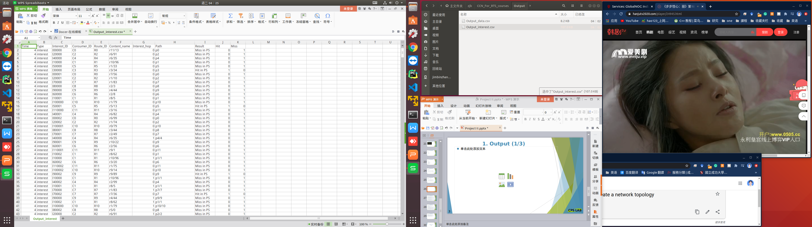
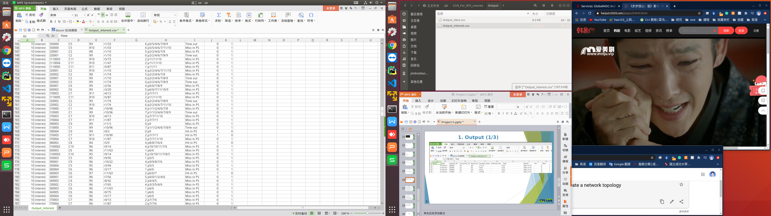
8. Output_interest

Slide 29
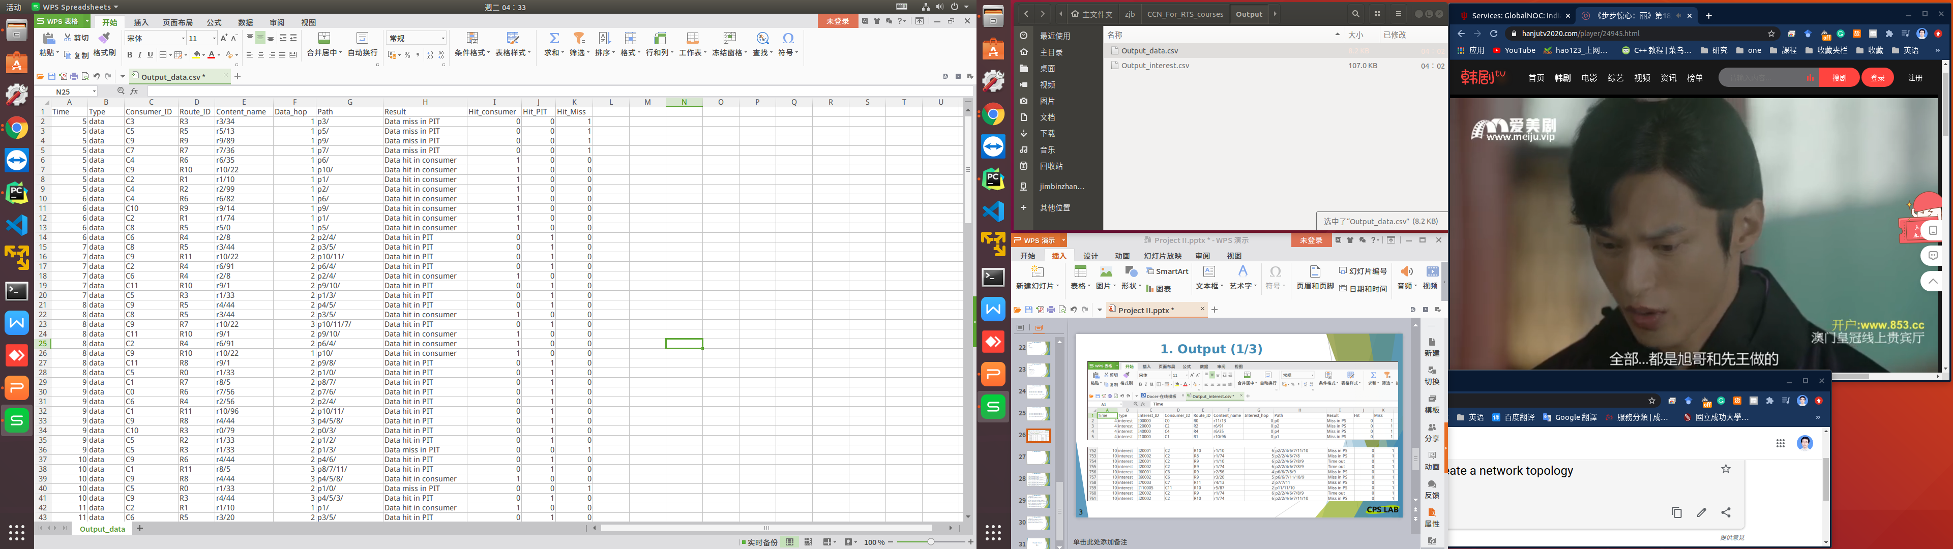
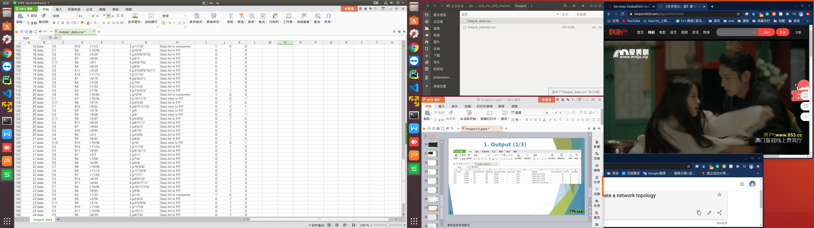
8. Output_data

Slide 30
9. Process Flow
Sever
Sever process
The network has 12 node. You can read from the networks JSON file .
networks format
= {'r'+'route_ID': [route_ID, ...], ... }
= {'r1': [0, 2], 'r2': [1, 3, 4], ... }
router0, ..., router11
N interests / s
network
Each node is both a producer and a consumer.
router ID = consumer ID = 0 1 ... 11
As a producer, router0 will publish the content name with its own router name prefix, for example 'r0/'. Each producer publishes 100 pieces of content, such as 'r0/00-99'. You can read from the producer_contents JSON file .
producer_contents format
= {'r'+'route_ID': [content_name, ...], ... }
= {'r0': ['r0/00', 'r0/01', ..., 'r0/99'], 'r1': ['r1/00', 'r1/01', ..., 'r1/99'], ... }

Slide 31
9. Process Flow
Sever
Sever process
As a consumer, router1can send out interest packet to request any content name with a router name prefix, such as 'r1/88'.
All routers simultaneously send out N new interests / s to the network.
router0, ..., router11
N interests / s
network
N = frequency. You can read from the parameters and interests JSON file based on the router name. interests has only interest_ID and content name. You need to fill in other information according to the complete format of the interest.
interests format
={"r0": [{'interest_ID': 0000,'content_name':'r1/3'}, ...], "r1": [{'interest_ID': 1000,'content_name':'r9/2'}, ...], ... "r11": [{'interest_ID': 1100,'content_name':'r6/7'}, ...]}
interest format
= {'type': 'interest', 'interest_ID': 0000, 'consumer_ID': 0, 'route_ID': 0, 'content_name': 'r0/00', 'interest_hop': 0, 'life_hop': 5, 'run_start_time': 0.0, 'path': 'p0/'}

Slide 32
9. Process Flow
Sever
Sever process
Get N in turn from the interests belonging to this router. And package them start_packets, and then hand them to the server to send them to the network.
router0, ..., router11
N interests / s
network
Interest packets format sent by consumer
start_packets
= [{'type': 'interest', 'interest_ID': '0300', 'consumer_ID': 3, 'route_ID': 3, 'content_name': 'r7/01', 'interest_hop': 0, 'life_hop': 5, 'run_start_time': 1615357629, 'path': 'p3/'},
.....
{'type': 'interest', 'interest_ID': '0304', 'consumer_ID': 3, 'route_ID': 3, 'content_name': 'r11/8', 'interest_hop': 0, 'life_hop': 5, 'run_start_time': 1615357629, 'path': 'p3/'}]

Slide 33
9. Process Flow
Sever
Sever process
When the accept receives a packet, it needs to read the type of packet and determine whether it is interest or data.
router0, ..., router11
N interests / s
packet
type ?
network
accept
data
> queue_size
drop data
data queue
If it is a data packet, you need to determine whether the data_queue size is greater than the queue_size. You can read the queue_size from the parameter JSON file.
If it is YES, it indicates that the data_queue is full, and the received packet is droped and not stored in the data_queue.
If NO, then store the received packet in the data_queue.

Slide 34
9. Process Flow
Sever
> queue_size
drop interest
interest queue
NO
Sever process
If it is a interest packet, you need to read the life_hop from the packet.
Then see if it is greater than 5. If YES, then drop the interest packet. Because we set an interest packet to have a life cycle of only 5 hops in the network.
life_hop>5 ?
YES
router0, ..., router11
drop interest
N interests / s
interest
packet
type ?
network
accept
data
> queue_size
drop data
data queue
If NO, you need to determine whether the interest_queue size is greater than the queue_size. You can read the queue_size from the parameter JSON file.
If it is YES, it indicates that the interest_queue is full, and the received packet is droped and not stored in the interest_queue.
If NO, then store the received packet in the interest_queue.

Slide 35
9. Process Flow
interest queue
Sever
> queue_size
drop interest
NO
Sever process
After the simulator runs for a fixed period of time, it exits. You can read run_time from the parameters JSON file.
The server monitors whether a packet is received in real time.
The router takes the first packet from the interest_queue and data_queue for processing each time.
life_hop>5 ?
YES
router0, ..., router11
drop interest
N interests / s
interest
packet
type ?
network
accept
data
> queue_size
drop data
data queue

Slide 36
9. Process Flow
return data
output hit
interest (name)
YES
hit ?
Router
process interest
interest queue
ps
Interest process
The router takes the first packet from the interest_queue for processing each time.
The router gets name from packet. Go to ps (producer store) to find if there is matching data.
ps stores 100 content published by each producer, such as 'r0/00-99'. You can read from the producer_contents JSON file.
ps format
= [content_name, ...]
If it hits, data packet is returned.

Slide 37
9. Process Flow
return data
output hit
interest (name)
YES
hit ?
Router
process interest
interest queue
ps
Interest process
Create a data packet.
data packet format
= [[5, {'type': 'data', 'consumer_ID': 0, 'route_ID': 9, 'content_name': 'r9/01', 'content_data': 'content_name' + str(current time), 'data_hop': 1, 'run_start_time': 1615357618, 'path': 'p9/'}]]
The first element 5 of the list represents the incoming interface (it is router_ID in interest) of the interest.
The second element of the list is a dictionary, which represents a data packet.
content_data format
= 'content_name' + str(current time)

Slide 38
9. Process Flow
return data
output hit
interest (name)
YES
hit ?
Router
process interest
interest queue
ps
Interest process
Output 'Interest hit in PS' to CSV.
Interest Output.CSV format
= [
"Time"=str(int(time.time()-interest['run_start_time']), "Type"=interest['type'], "Interest_ID"='I'+str(interest['interest_ID']), "Consumer_ID"='C'+str(interest['consumer_ID']), "Route_ID"='R'+str(interest['route_ID']), "Content_name"=interest['content_name'], "Interest_hop"=interest['interest_hop'], "Path"=interest['path'], "Result"='Interest hit in PS', "Hit"=1, "Miss"=0
]

Slide 39
9. Process Flow
return data
output hit
interest (name)
YES
hit ?
Router
process interest
interest queue
ps
Interest process
If miss in ps, output 'Interest miss in PS' to CSV. The format following above.
And go to pit to find a matching entry by content_name.
pit format
= {'content_name': [[inface, ...], [outface, ...]], ... }
PIT_entry format
= [[inface, ...], [outface, ...]]
output miss
NO
pit
drop interest
name
hit ?
YES
mage inface to PIT_entry

Slide 40
9. Process Flow
return data
output hit
interest (name)
YES
hit ?
Router
process interest
interest queue
ps
Interest process
If it hits, it means that the interest requesting the same content name has been received and forwarded, and this interest only needs to wait for data to return. So merge the incoming interface (it is router_ID in interest) into the inface of entry.
PIT_entry format
= [[inface, ...], [outface, ...]]
You may want to check to make sure that there is no duplicate inface in PIT_entry .
And then drop the interest. The router takes a data packet from the data_queue for processing.
output miss
NO
pit
drop interest
name
hit ?
YES
mage inface to pit_entry

Slide 41
9. Process Flow
return data
output hit
interest (name)
YES
hit ?
Router
process interest
interest queue
ps
Interest process
If content name miss in pit, create a new entry in pit to record the content name and inface (it is router_ID in interest).
PIT_entry
= [[inface], []]
pit
= {... , 'content_name': [[inface], []]}
output miss
NO
pit
drop interest
name
hit ?
YES
mage inface to PIT_entry
NO
create a PIT_entry

Slide 42
9. Process Flow
return data
output hit
interest (name)
YES
hit ?
Router
process interest
interest queue
ps
Interest process
Then forward the interest to all neighbors. You can obtain the outgoing interfaces with neighbors from the network by router_ID (Current router, not router_ID in interest).
networks
= {''r0'':[1, 3], ''r1'': [0, 2, 3], ''r2'': [1, 4], ... , ''r11'': [7, 10]}
outfaces
= [0, 2, 3]
And record these outgoing interfaces in the outface of the matching entry in pit.
PIT_entry
= [[inface], [outface, ...]]
pit
= {... , 'content_name': [[inface], [outface, ...]]}
output miss
NO
pit
drop interest
name
hit ?
YES
mage inface to PIT_entry
NO
create a PIT_entry
brocast all neighbors
get outfaces in network
add outfaces to PIT_entry
forward interests

Slide 43
9. Process Flow
return data
output hit
interest (name)
YES
hit ?
Router
process interest
interest queue
ps
Interest process
interest miss in ps
Create forwarding interest packets, which may need to be forwarded to multiple output interfaces. The first number of each list is the outface (router ID).
interest packets format
=[[7, {'type': 'interest', 'interest_ID': '0001', 'consumer_ID': 0, 'route_ID': 5, 'content_name': 'r7/07', 'interest_hop': 3, 'life_hop': 5, 'start_time': 1615357599, 'path': 'p0/3/5'}],
[4, {'type': 'interest', 'interest_ID': '0001', 'consumer_ID': 0, 'route_ID': 5, 'content_name': 'r7/07', 'interest_hop': 3, 'life_hop': 5, 'start_time': 1615357599, 'path': 'p0/3/5'}],
[8, {'type': 'interest', 'interest_ID': '0001', 'consumer_ID': 0, 'route_ID': 5, 'content_name': 'r7/07', 'interest_hop': 3, 'life_hop': 5, 'start_time': 1615357599, 'path': 'p0/3/5'}]]
The interest packets is forwarded by the server.
output miss
NO
pit
drop interest
name
hit ?
YES
mage inface to PIT_entry
NO
create a PIT_entry
brocast all neighbors
get outfaces in network
add outfaces to PIT_entry
forward interests

Slide 44
9. Process Flow
Data process
The router takes the first packet from the data_queue for processing each time.
The router gets name from packet. Go to pit to find if there is matching name.
pit format
= {'content_name': [[inface, ...], [outface, ...]], ... }
If it miss, data is droped. The router takes a interest packet from the interest_queue for processing.
Output 'Data miss in PIT' to CSV.
data
name
Router
process data
PIT
data queue
hit ?
NO
output miss
drop data

Slide 45
9. Process Flow
Data process
Output 'Data miss in PIT' to CSV.
Data Output.CSV format
=[
"Time"=str(times-data['run_start_time']), "Type"=data['type'], "Consumer_ID"='C'+str(data['consumer_ID']), "Route_ID"='R'+str(data['route_ID']), "Content_name"=data['content_name'], "Data_hop"=data['data_hop'], "Path"=data['path'], "Result"='Data miss in PIT', "Hit_consumer"=0, "Hit_PIT"=0, "Hit_Miss"=1
]
data
name
Router
process data
PIT
data queue
hit ?
NO
output miss
drop data

Slide 46
9. Process Flow
Data process
Otherwise, it means that this is the first data returned for this name. Get the incoming interfaces from the PIT_entry.
pit format
= {'content_name': [[inface, ...], [outface, ...]], ... }
PIT_entry format
= [[inface, ...], [outface, ...]]
Output 'Data hit in PIT' to CSV. The format following above.
output hit
data
name
Router
process data
PIT
data queue
hit ?
YES
get infaces in PIT entry
NO
output miss
drop data

Slide 47
9. Process Flow
Data process
Determine whether the current router_ID is equal to the consumer_ID in the data packet. If yes, it means that the consumer has received a data response. Output 'Data hit in consumer' to CSV.
Data Output.CSV format
=["Time"=str(times-data['run_start_time']), "Type"=data['type'], "Consumer_ID"='C'+str(data['consumer_ID']), "Route_ID"='R'+str(data['route_ID']), "Content_name"=data['content_name'], "Data_hop"=data['data_hop'], "Path"=data['path'], "Result"='Data hit in consumer', "Hit_consumer"=1, "Hit_PIT"=1, "Hit_Miss"=0]
output hit
data
name
Router
process data
PIT
data queue
YES
output hit
hit ?
get infaces in PIT entry
Yes consumer
NO
output miss
router ID
==
consumerID ?
YES
drop data
remove PIT entry

Slide 48
9. Process Flow
Data process
Remove this content_name record from pit.
Otherwise, forward the data packet to all routers on the incoming interface and remove this content_name record from pit.
pit format
= {'content_name': [[inface, ...], [outface, ...]], ... }
output hit
data
name
Router
process data
pit
data queue
YES
output hit
hit ?
get infaces in PIT_entry
Yes consumer
NO
output miss
router ID
==
consumerID ?
YES
drop data
NO
forward datas
remove name record in pit

Slide 49
9. Process Flow
Data process
data hit in pit
Create forwarding data packets, which may need to be forwarded to multiple incoming interfaces. The first number of each list is the incoming interface (next router ID).
data packets format
= [[2, {'type': 'data', 'consumer_ID': 0, 'route_ID': 4, 'content_name': 'r5/09', 'content_data': '', 'data_hop': 2, 'start_time': 1615357615, 'path': 'p5/4/'}],
[6, {'type': 'data', 'consumer_ID': 0, 'route_ID': 4, 'content_name': 'r5/09', 'content_data': '', 'data_hop': 2, 'start_time': 1615357615, 'path': 'p5/4/'}]]
The data packets is forwarded by the server.
name
Router
process data
PIT
output hit
output hit
YES
output hit
hit ?
get infaces in PIT entry
Yes consumer
Yes consumer
NO
output miss
router ID
==
consumerID ?
router ID
==
consumerID ?
YES
drop data
NO
forward datas
forward datas
remove PIT entry
remove PIT entry

Slide 50
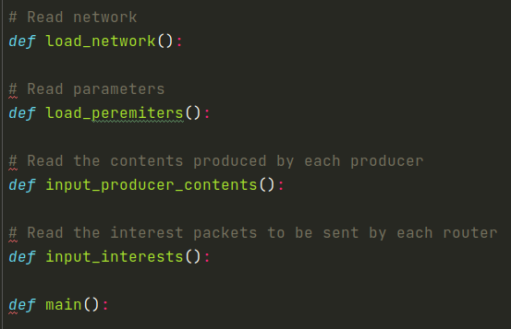
10. Coding----main.py
Network is a dict.
key = router name ex. 'r0'
value = [router ID, ...] ex. [1, 3]
Peremiters is a dict.
key = Peremiter name ex.'route_num'
value = Peremiter value ex. 12
Producer contents is a dict.
key = Producer ID ex. 'p1'
value = [Content name, ...] ex. ['r1/0', 'r1/99']
Interests is a dict.
key = router ID ex. 'r1'
value = [{'interest ID': , 'Content name': }, ...] ex. [{'interest ID': 0001, 'Content name': 'r1/99'}]
Initialization parameters
Get the time when the simulator started running run_start_time
Build a server for each router
At regular intervals（frequency） in the while loop, all routers send out new interest packets to the network. At the same time, it keeps checking whether the simulator end time is up.

Slide 51
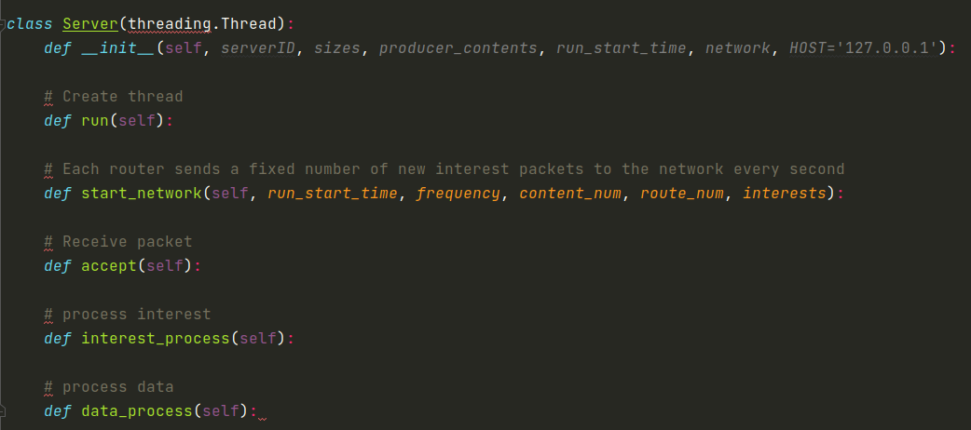
10. Coding----server.py
create a accept thread
create a interest_process thread
create a data_process thread
The router sends a new interest packet to the network.
Monitor whether a packet is received. If packet is received, read the packet type to determine whether it is interest or data packet. Then store the packet in the corresponding queue. At this time, to determine whether queue is full. If it is full, drop this packet, otherwise save it.
The router takes the first interest packet from interest_queue for processing
The router takes the first data packet from data_queue for processing

Slide 52
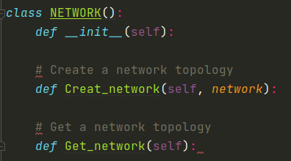
10. Coding----network.py
Create a network dictionary.
Create a network dictionary, assign the network dictionary read from the networks JSON file to it, and return this dictionary.
return network dictionary.

Slide 53
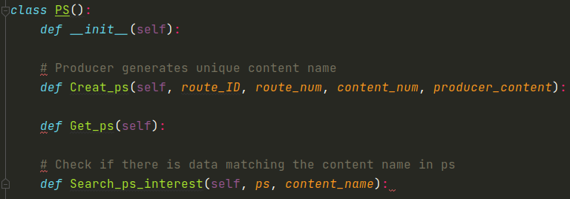
10. Coding----ps.py
Create an empty ps list.
Store the producer contents of the current router read from the producer content JSON file into ps list of router.
return ps list of router.
get the content name from the interest packet, and look for matching data in ps. If it matches, return TRUE, otherwise return FALSE.

Slide 54
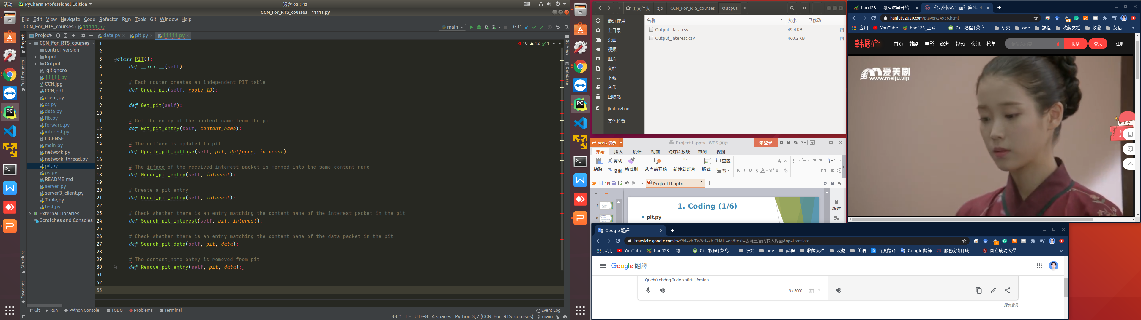
10. Coding----pit.py
Create an empty pit dictionary.
return an pit dictionary.
return an pit dictionary.
Get the value (PIT_entry list) from the pit dictionary with the content name as the key and return it.
Get the value (PIT_entry list) from the pit dictionary with the content name as the key. Add the outfaces to the outface of the PIT_entry list.
Get the value (PIT_entry list) from the pit dictionary with the content name as the key. Merge the inface (route_ID of interest) to the inface of the PIT_entry list. At the same time, make sure that the inface is not repeated in inface of the PIT_entry list.

Slide 55
10. Coding----pit.py
Create a PIT_entry in the pit dictionary with the content name. Add the inface (route_ID of interest) to the inface of the PIT_entry.
Get content name from the interest. Check matching PIT_entry in pit. If it matches, merge incoming interface (route_ID of interest) into inface of PIT_entry and return FALSE. Otherwise create a new PIT_entry in pit and return TRUE.
Get the content name from the data packet. Check matching PIT_entry in pit. If it matches, return TRUE. Otherwise return FALSE.
Get the content name from the data packet. Check matching PIT_entry in pit. If it matches, return TRUE. Otherwise return FALSE.

Slide 56
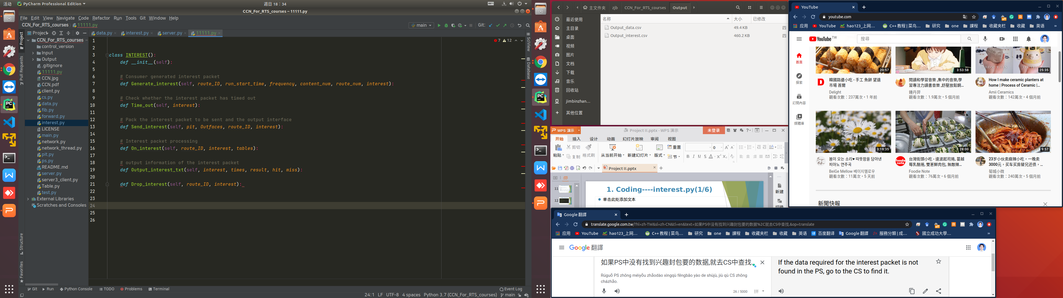
10. Coding----interest.py
Create a interest dictionary.
Get N new interest packets belonging to this router from the interest JSON file. And reconstruct it according to the complete interest packet format. Note that the life_hop is set to 5. Pack them in a list and return.
Determine whether the interest_hop of the interest is greater than the life_hop. If yes, return an error and drop the interest , without recording it in the interest_queue.
Pack interests to be forwarded into a list according to the outfaces. The interest_hop is added by 1, and the path of interest is added to the current router ID. At the same time, the outfaces is updated to the PIT_entry matching content_name.

Slide 57
10. Coding----interest.py
Get content name from the interest packet. Check if there is matching data in ps. If there is a match, create a data packet. Then output the information that the ''interest hits in ps'' to CSV and return the data packet.
Otherwise, output the information that the “interest miss in ps” to interest.CSV.
Output interest packet information and write to interest.CSV
Output the information of interest packet and write it to interest.CSV

Slide 58
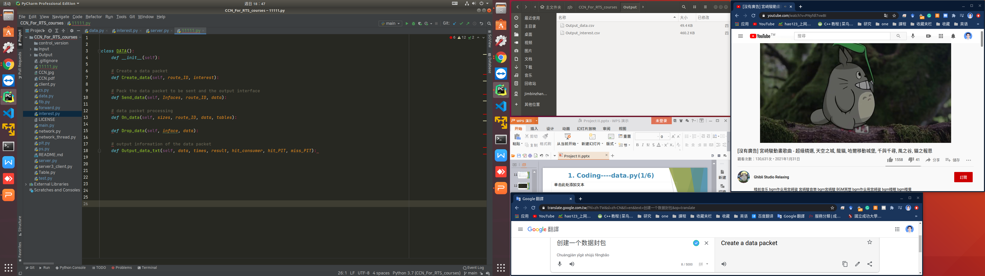
10. Coding----data.py
Create a data packet dictionary.
Create a data packet according to the complete data packet format. The content data is a random number ranging from 0 to 100,000.
Pack datas to be forwarded into a list according to the infaces. The data_hop is added by 1, and the path of data is added to the current router ID.
Get content name from the data packet. Check if there is matching data in pit. If there is a match, then check whether the router ID is the same as the consumer ID. If yes, output the information that the “data hit in consumer” to data.CSV.
Otherwise, output the information that the “data hit in pit” to data.CSV and forward data packet.
If not match in pit, output the information that the “data miss in pit” to data.CSV.

Slide 59
10. Coding----data.py
Output the drop information of data packet and write it to data.CSV
Output the information of data packet and write it to data.CSV

Slide 60
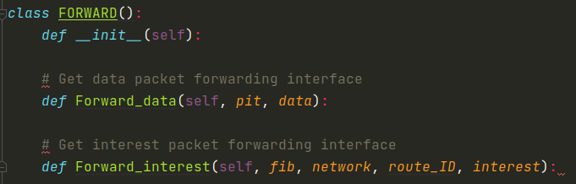
10. Coding----forward.py
Get the inface (router ID) from the data packet. Get the PIT_entry matching the content name from the pit. Then pack the infaces of the PIT_entry except for the same as the inface into the Infaces, and return it.
Prevent data packet from being transmitted back to the previous router.
Get the inface (router ID) from the inteseat packet. Get the FIB_entry matching the router ID from the network. Then pack the outfaces of the FIB_entry except for the same as the inface into the Outfaces, and return it.
Prevent interest packet from being transmitted back to the previous router.

Slide 61
Thank You !
Q&A
Email：P780083025@ncku.edu.tw

